Slide 1

Group 6: Data Science Project
Company – TKL Logistics

Slide 2

Objectives
TKL had presented us with 3 main objectives:
Prediction of ETA
Compare options in regards of price and CO2 in real time
Rank transporters in terms of historic delivery performance
The team has worked together to solve each of these.
Let’s look at the process we followed and the conclusions we reached in each scenario.

Slide 3

Predictability Of ETA
Process
Business and Data Understanding
Enhance the predictability of ETA using historical data.
TKL site was explored to get better understanding of freight booking process.
Data Cleaning
Issues with Date columns
EntryDates, LoadingDates, UnloadingDates, OriginalETAs, and DeliveryDates.
Incorrect values for years. For example; ‘2323-07-13’
Data Type Issue - Given as String with timestamp. Eg:- ‘2021-01-15T00:00:00’
EntryDates column was not required for the analysis

Slide 4
Predicting ETA
Average ETA column was developed using the dates data and the estimate provided by the business team
Missing values
Feature Selection – shows the relevant columns
Predicting the ETA - Using the Transport Date and Delivery Date

Slide 5

Key Observations
Proper cleaning of the data is required
Handle the accuracy while entering the data, to reduce error in future data
With proper cleaning and feature selection, we can achieve a good accuracy in predicting the ETA

Slide 6

Price and CO2 Comparison
Both Price and CO2 are based on mathematical calculations.
To understand the factors that influence price and CO2, we analysed the data and plotted graphs.
Let’s look at some graphs to understand the correlation.

Slide 7
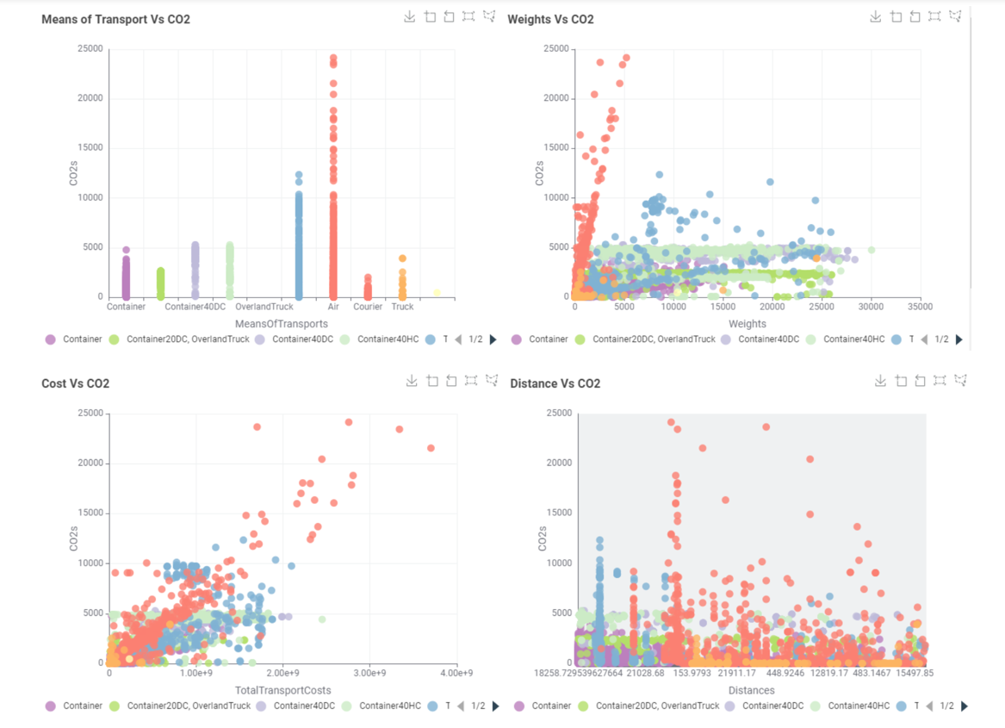
How various factors affect CO2 ?

Slide 8
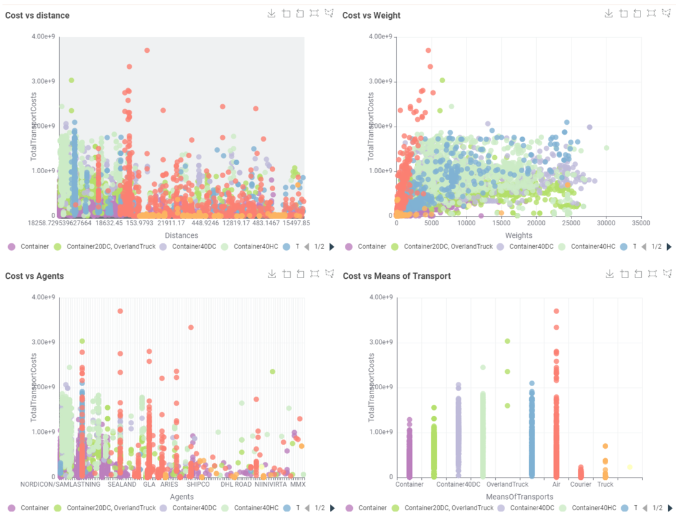
How various factors affect the transport cost ?

Slide 9

Factors Influencing CO2 and Price
Means of Transport
Distance
Weight
Transport days

Slide 10
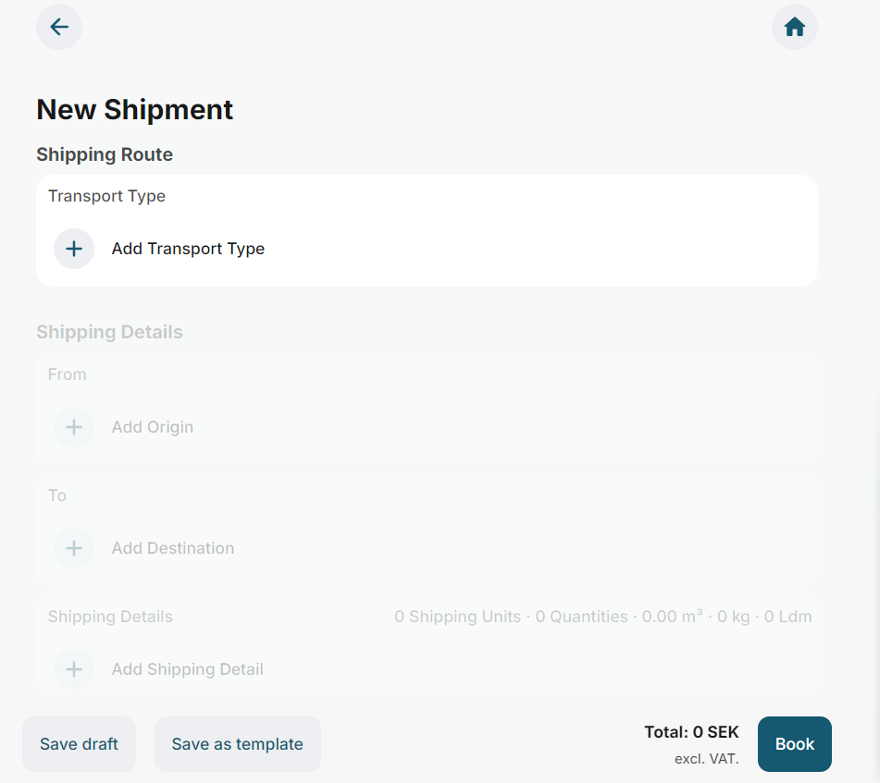

Slide 11
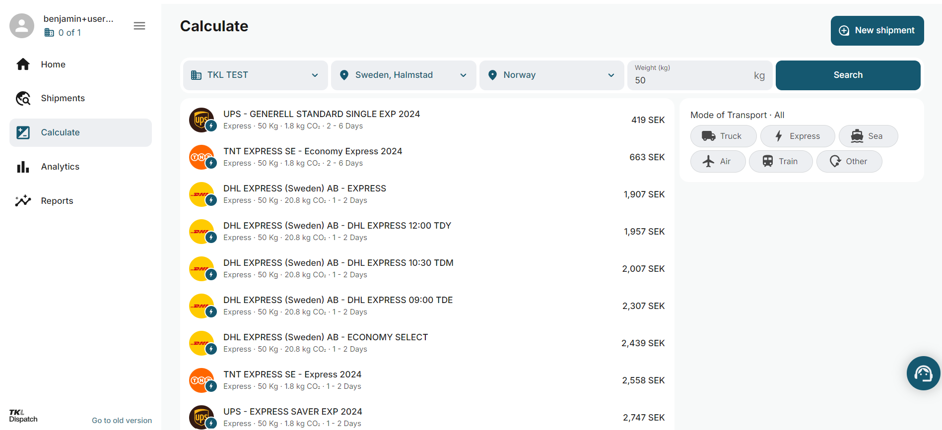

Slide 12
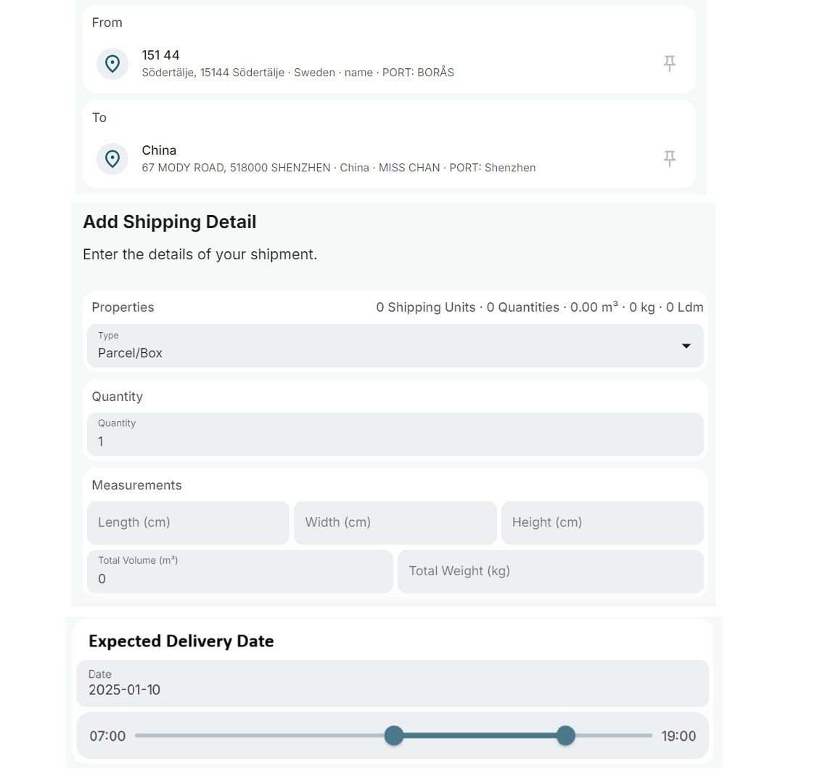

Slide 13
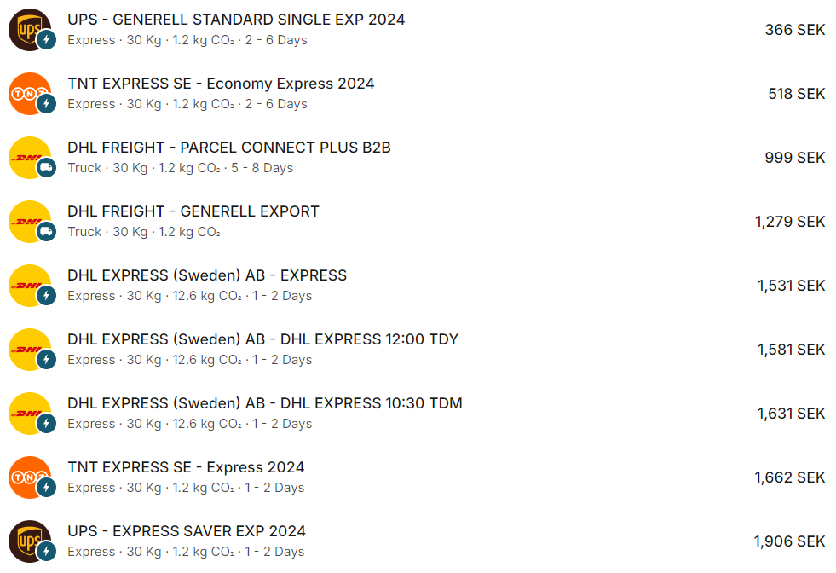

Slide 14
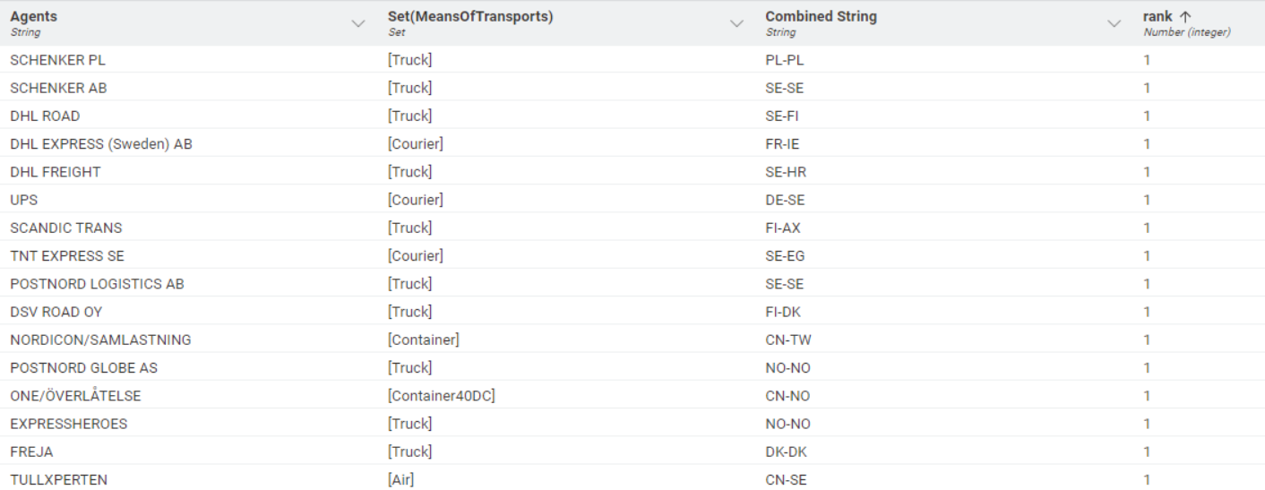
Agent ranking based on Performance

Slide 15

What data do we have ?
How is it accessible ?
How do we structure the data ?
Do we need to “clean” the data ?
What historical data can we use ?

Slide 16
What real-time data can we use? Realtime, the essential data that is needed for predictions would be,
From ISO
To ISO
From ZipCode
To ZipCode
CO2
Agents
Means Of Transport
Total Transport Cost
Number Of Pieces
Distances
Weights

Slide 17

What infrastructure is needed?
To run the models for prediction, a minimalist backend server should have
4-8GB of RAM
5-10GB of Storage space as a HDD or an SSD and
a CPU that has at least 2 cores and with a clock-speed of 2.0GHz.
This is largely due to the saved models of Random Forest being as large as
700-800Mb in size.

Slide 18

Language model?
The best model for our purpose, after trying out multiple models, turns out to be the Random Forest model, only slightly better than the Gradient Boosted Trees Model.
Although regression models are predictive models, they cannot be considered a Language model as they serve different purposes and are applied to distinct contexts.

Slide 19
Thank You……

